Slide 1
Linking Strategy with Execution
Proposal for an enterprise change management framework
Jeff Wallk
Notes:
Sciacca

Slide 2
First, let’s provide some context
Change is all about moving from one steady state to another steady state.
Change Management is used to control how change is governed and executed to ensure the new steady state is achieved.
Strategy is used to provide a roadmap of incremental changes to achieve a vision and set of corporate goals
Operations management is about executing a steady state with maximum efficiency and quality.
Assuming the strategy is correct, then the key for achieving success is based on how well we execute change to move the company incrementally forward to achieve the vision and goals.
Jeff Wallk

Slide 3
What’s the problem ?
The problem with executing strategy is that there is uncertainty associated with moving between steady states when implementing change:
  It’s hard to measure progress
  It’s hard to estimate the costs (time & effort)
  It’s hard to gage success once you reach steady state
  It’s hard (and risky) if you’re managing multiple changes at the same time.
  It’s hard to prioritize change since the ROI around change is not always clear.
Jeff Wallk

Slide 4
What’s the solution ?
We introduce a new methodology:
  Leverages many of the existing processes used to manage change.
  Links strategy with execution management to ensure change achieves the desired goals.
  Ensures progress and success can be measured.
  Provides the business with a consistent approach for managing business and product change as we drive forward with corporate strategy.
  Drives consistent metrics-driven for governing change
Jeff Wallk

Slide 5
Sounds good, what’s the value ?
Ability to track incremental progress associated with change across the company
Provides traceability throughout change management to ensure we are tracking in accordance with strategy
Promotes reusability
Improves our ability to associate change (costs) with business value (benefits)
Improves our ability to manage the Demand for change
Improves our ability to anticipate the impact of change
Improves our ability to estimate (time & effort) for implementing change
Jeff Wallk

Slide 6
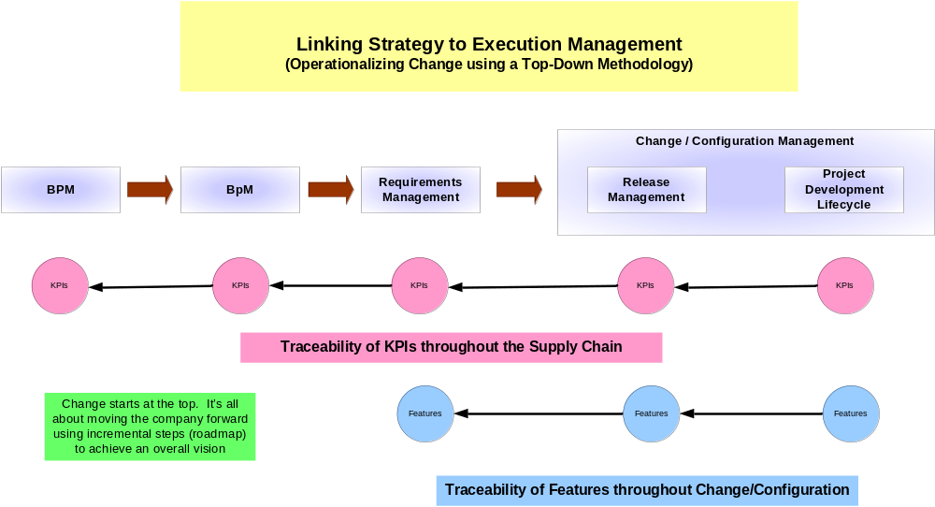
Here’s the framework:
Jeff Wallk

Slide 7
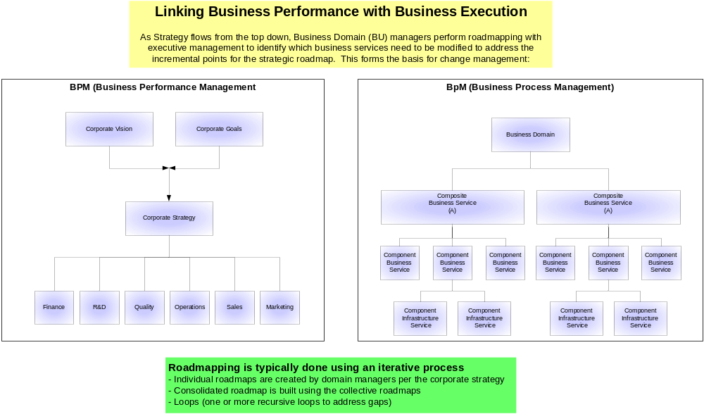
Here’s the framework:
Jeff Wallk

Slide 8
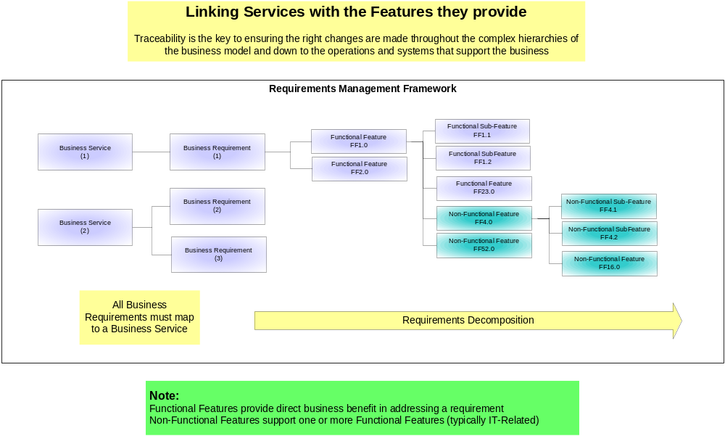
Here’s the framework:
Jeff Wallk

Slide 9
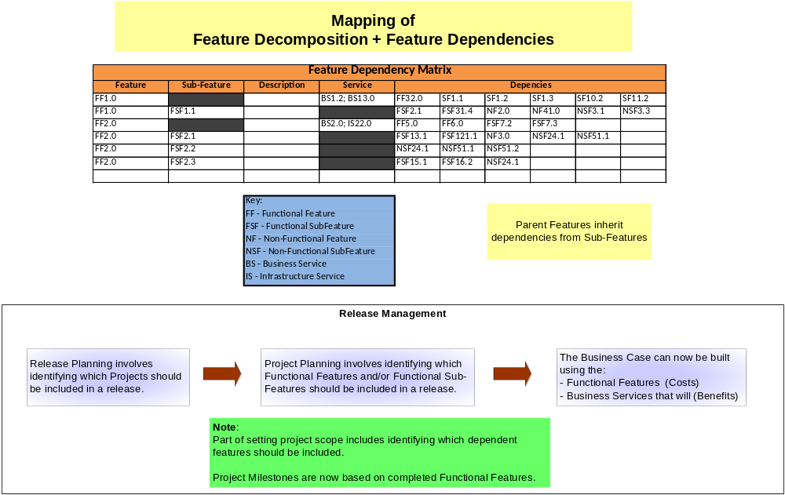
Here’s the framework:
Jeff Wallk

Slide 10
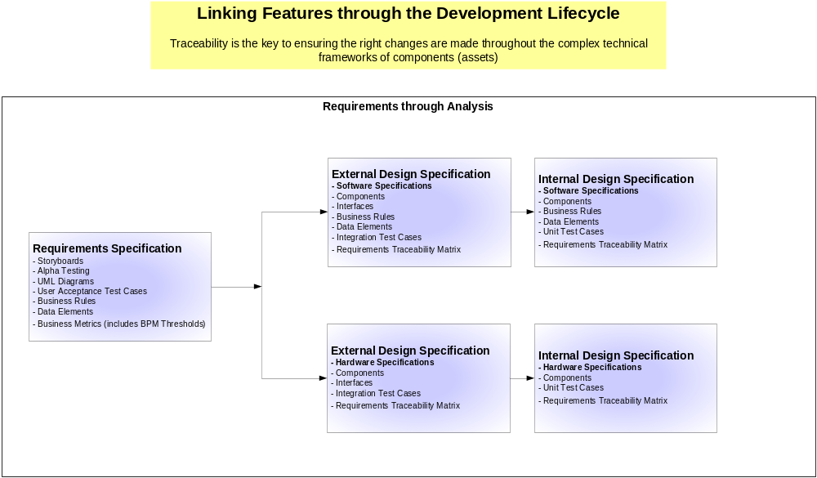
Here’s the framework:
Jeff Wallk

Slide 11
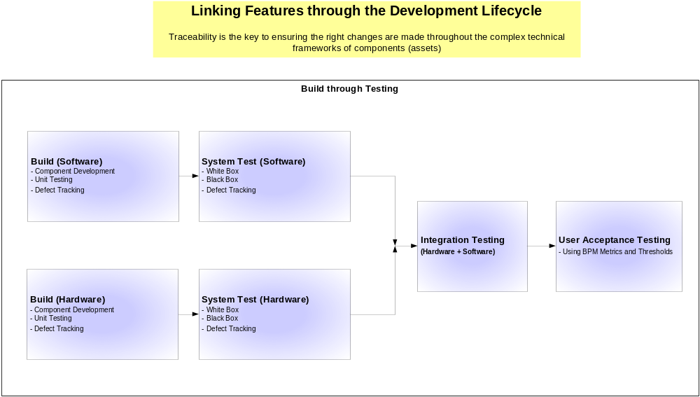
Here’s the framework:
Jeff Wallk

Slide 12
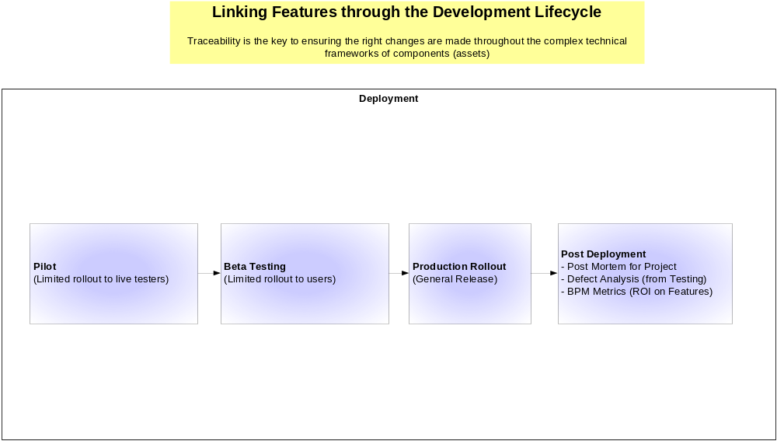
Here’s the framework:
Jeff Wallk

